Slide 1
Introduction to depiction
IBM Research
Notes:
Introductory information, maybe a couple of jokes
Let's start...

Slide 2
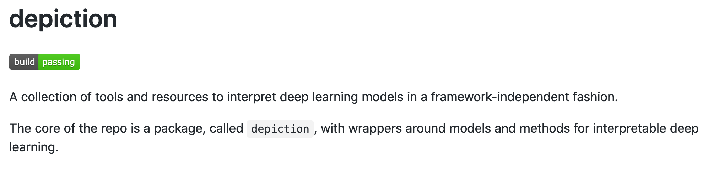
What is depiction?
Notes:
Interpretability is one of those concepts that everybody kinda knows what it is, but at the same time is difficult to pinpoint. So before talking about what interpretability is, let's first see why we would want it.
I do research in interpretability with applications in systems biology and healthcare so I have 3 main reasons why I'd like to achieve interpretability, whatever that is.

Slide 3
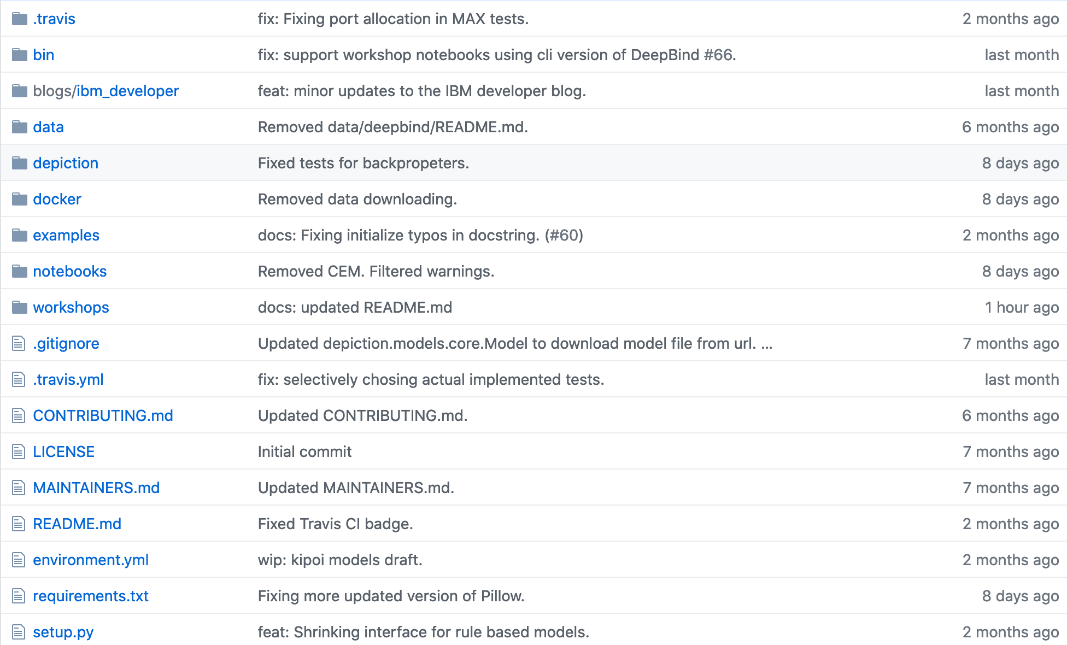
Overview
Notes:
Interpretability is one of those concepts that everybody kinda knows what it is, but at the same time is difficult to pinpoint. So before talking about what interpretability is, let's first see why we would want it.
I do research in interpretability with applications in systems biology and healthcare so I have 3 main reasons why I'd like to achieve interpretability, whatever that is.

Slide 4
Overview
Notes:
Interpretability is one of those concepts that everybody kinda knows what it is, but at the same time is difficult to pinpoint. So before talking about what interpretability is, let's first see why we would want it.
I do research in interpretability with applications in systems biology and healthcare so I have 3 main reasons why I'd like to achieve interpretability, whatever that is.

Slide 5
Overview
Notes:
Interpretability is one of those concepts that everybody kinda knows what it is, but at the same time is difficult to pinpoint. So before talking about what interpretability is, let's first see why we would want it.
I do research in interpretability with applications in systems biology and healthcare so I have 3 main reasons why I'd like to achieve interpretability, whatever that is.

Slide 6
Overview
Notes:
Interpretability is one of those concepts that everybody kinda knows what it is, but at the same time is difficult to pinpoint. So before talking about what interpretability is, let's first see why we would want it.
I do research in interpretability with applications in systems biology and healthcare so I have 3 main reasons why I'd like to achieve interpretability, whatever that is.

Slide 7
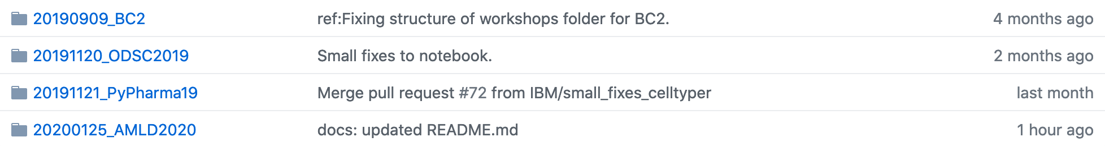
Overview
Notes:
Interpretability is one of those concepts that everybody kinda knows what it is, but at the same time is difficult to pinpoint. So before talking about what interpretability is, let's first see why we would want it.
I do research in interpretability with applications in systems biology and healthcare so I have 3 main reasons why I'd like to achieve interpretability, whatever that is.

Slide 8
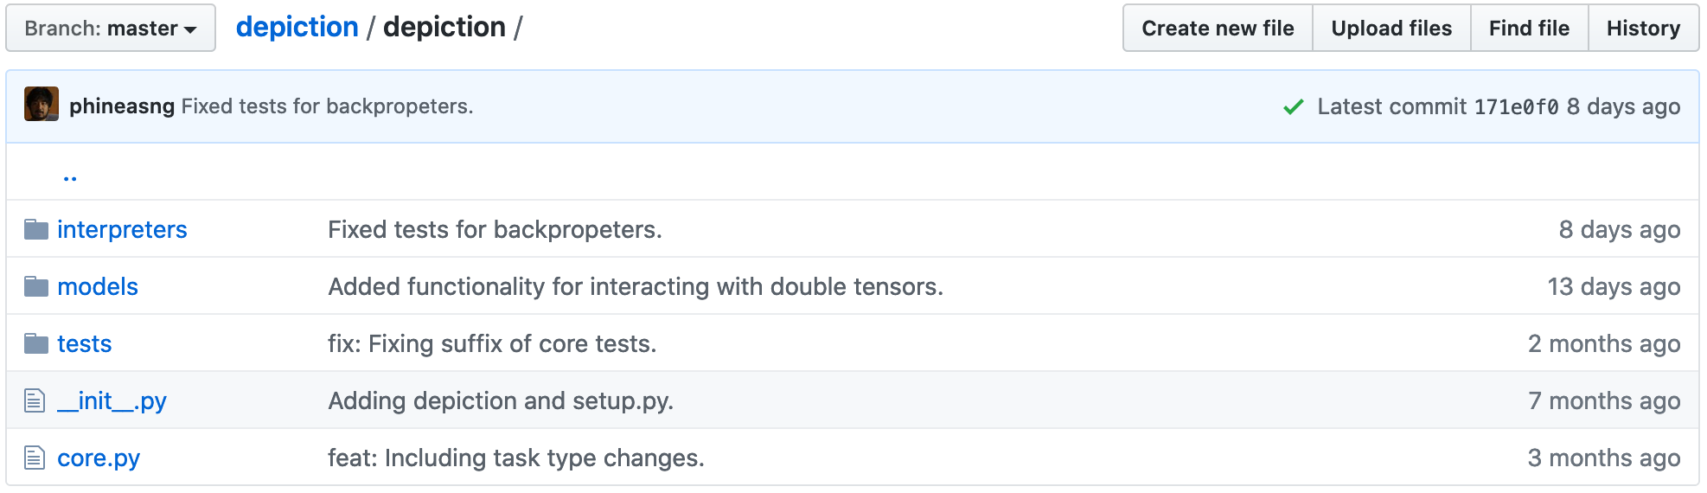
Main components
Notes:
Interpretability is one of those concepts that everybody kinda knows what it is, but at the same time is difficult to pinpoint. So before talking about what interpretability is, let's first see why we would want it.
I do research in interpretability with applications in systems biology and healthcare so I have 3 main reasons why I'd like to achieve interpretability, whatever that is.

Slide 9
Main components
Notes:
Interpretability is one of those concepts that everybody kinda knows what it is, but at the same time is difficult to pinpoint. So before talking about what interpretability is, let's first see why we would want it.
I do research in interpretability with applications in systems biology and healthcare so I have 3 main reasons why I'd like to achieve interpretability, whatever that is.

Slide 10
Main components
Notes:
Interpretability is one of those concepts that everybody kinda knows what it is, but at the same time is difficult to pinpoint. So before talking about what interpretability is, let's first see why we would want it.
I do research in interpretability with applications in systems biology and healthcare so I have 3 main reasons why I'd like to achieve interpretability, whatever that is.

Slide 11
Main components
Notes:
Interpretability is one of those concepts that everybody kinda knows what it is, but at the same time is difficult to pinpoint. So before talking about what interpretability is, let's first see why we would want it.
I do research in interpretability with applications in systems biology and healthcare so I have 3 main reasons why I'd like to achieve interpretability, whatever that is.

Slide 12
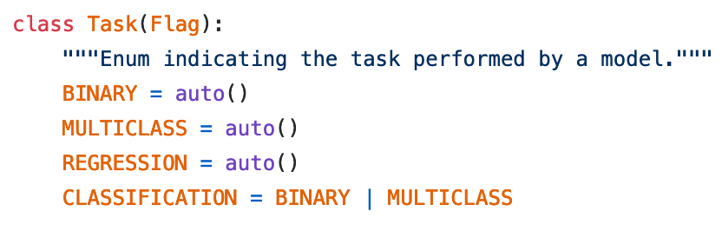
Tasks and data
Notes:
Interpretability is one of those concepts that everybody kinda knows what it is, but at the same time is difficult to pinpoint. So before talking about what interpretability is, let's first see why we would want it.
I do research in interpretability with applications in systems biology and healthcare so I have 3 main reasons why I'd like to achieve interpretability, whatever that is.

Slide 13
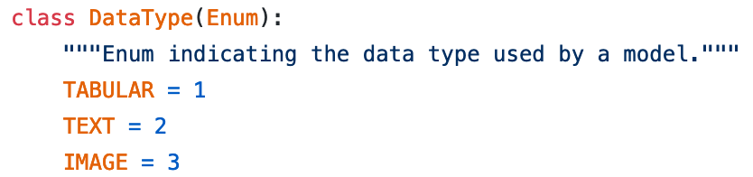
Tasks and data
Notes:
Interpretability is one of those concepts that everybody kinda knows what it is, but at the same time is difficult to pinpoint. So before talking about what interpretability is, let's first see why we would want it.
I do research in interpretability with applications in systems biology and healthcare so I have 3 main reasons why I'd like to achieve interpretability, whatever that is.

Slide 14
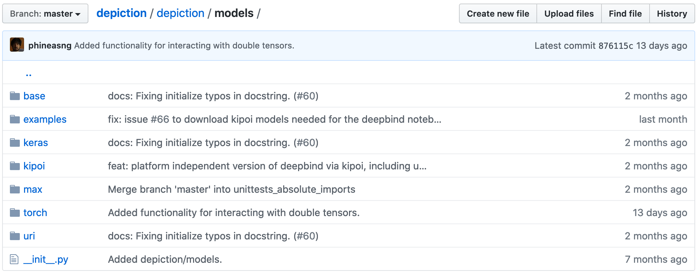
Models interface
Notes:
Interpretability is one of those concepts that everybody kinda knows what it is, but at the same time is difficult to pinpoint. So before talking about what interpretability is, let's first see why we would want it.
I do research in interpretability with applications in systems biology and healthcare so I have 3 main reasons why I'd like to achieve interpretability, whatever that is.

Slide 15
Models interface
Notes:
Interpretability is one of those concepts that everybody kinda knows what it is, but at the same time is difficult to pinpoint. So before talking about what interpretability is, let's first see why we would want it.
I do research in interpretability with applications in systems biology and healthcare so I have 3 main reasons why I'd like to achieve interpretability, whatever that is.

Slide 16
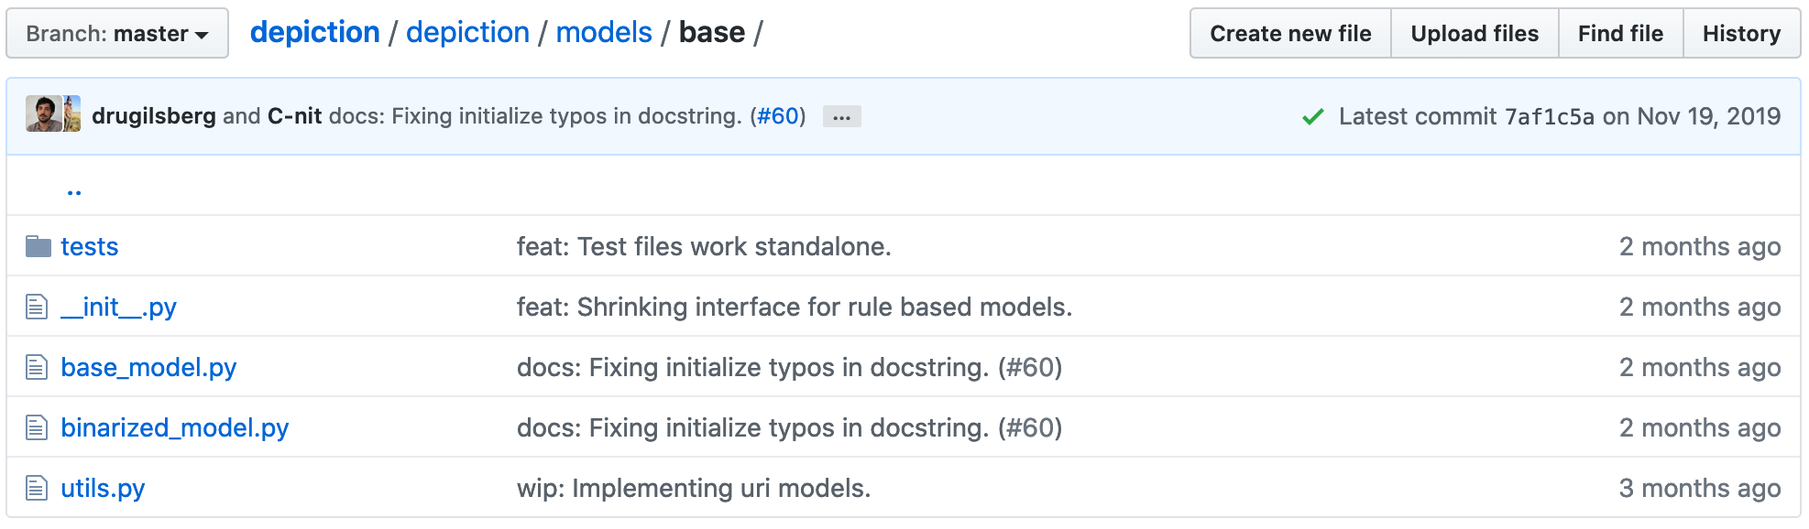
Models interface
Notes:
Interpretability is one of those concepts that everybody kinda knows what it is, but at the same time is difficult to pinpoint. So before talking about what interpretability is, let's first see why we would want it.
I do research in interpretability with applications in systems biology and healthcare so I have 3 main reasons why I'd like to achieve interpretability, whatever that is.

Slide 17
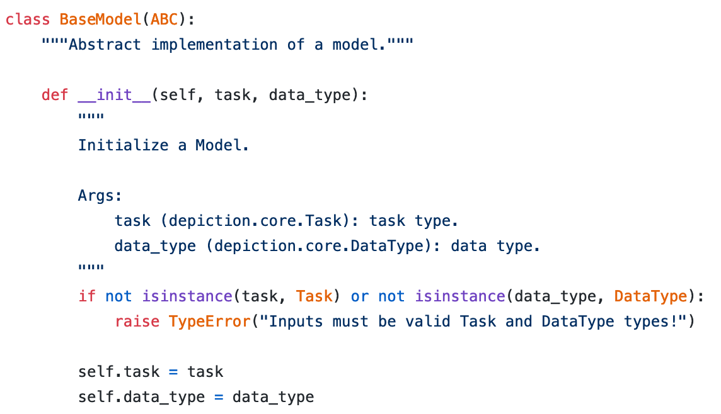
Models interface
Notes:
Interpretability is one of those concepts that everybody kinda knows what it is, but at the same time is difficult to pinpoint. So before talking about what interpretability is, let's first see why we would want it.
I do research in interpretability with applications in systems biology and healthcare so I have 3 main reasons why I'd like to achieve interpretability, whatever that is.

Slide 18
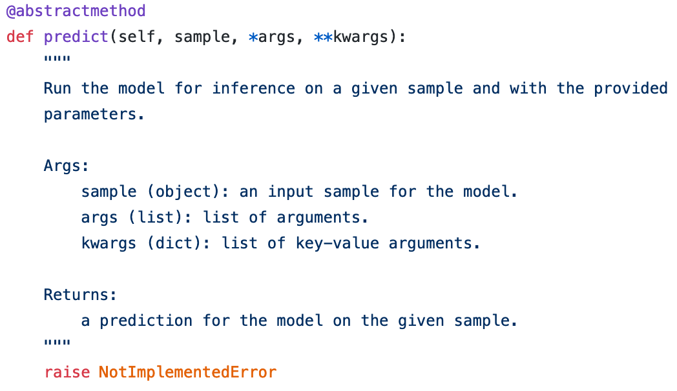
Models interface
Notes:
Interpretability is one of those concepts that everybody kinda knows what it is, but at the same time is difficult to pinpoint. So before talking about what interpretability is, let's first see why we would want it.
I do research in interpretability with applications in systems biology and healthcare so I have 3 main reasons why I'd like to achieve interpretability, whatever that is.

Slide 19
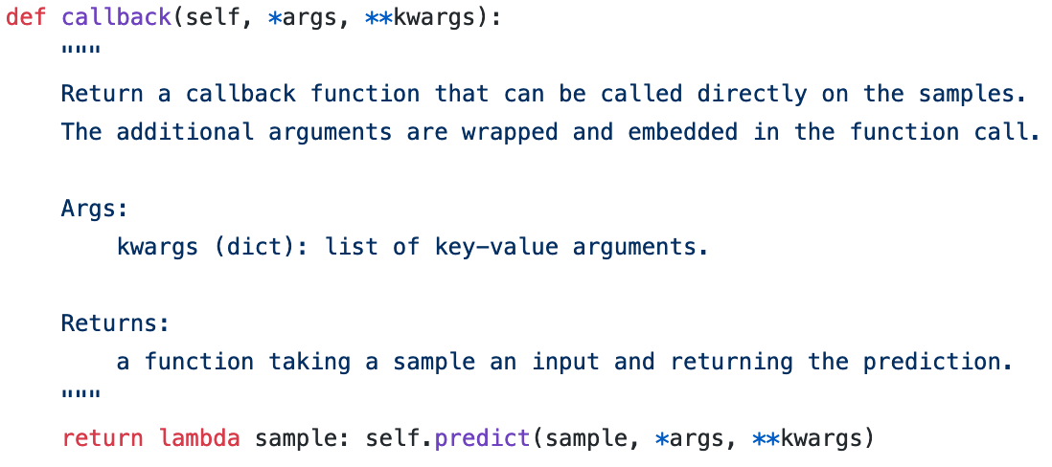
Models interface
Notes:
Interpretability is one of those concepts that everybody kinda knows what it is, but at the same time is difficult to pinpoint. So before talking about what interpretability is, let's first see why we would want it.
I do research in interpretability with applications in systems biology and healthcare so I have 3 main reasons why I'd like to achieve interpretability, whatever that is.

Slide 20
Models interface
Notes:
Interpretability is one of those concepts that everybody kinda knows what it is, but at the same time is difficult to pinpoint. So before talking about what interpretability is, let's first see why we would want it.
I do research in interpretability with applications in systems biology and healthcare so I have 3 main reasons why I'd like to achieve interpretability, whatever that is.

Slide 21
Example: Keras
Notes:
Interpretability is one of those concepts that everybody kinda knows what it is, but at the same time is difficult to pinpoint. So before talking about what interpretability is, let's first see why we would want it.
I do research in interpretability with applications in systems biology and healthcare so I have 3 main reasons why I'd like to achieve interpretability, whatever that is.

Slide 22
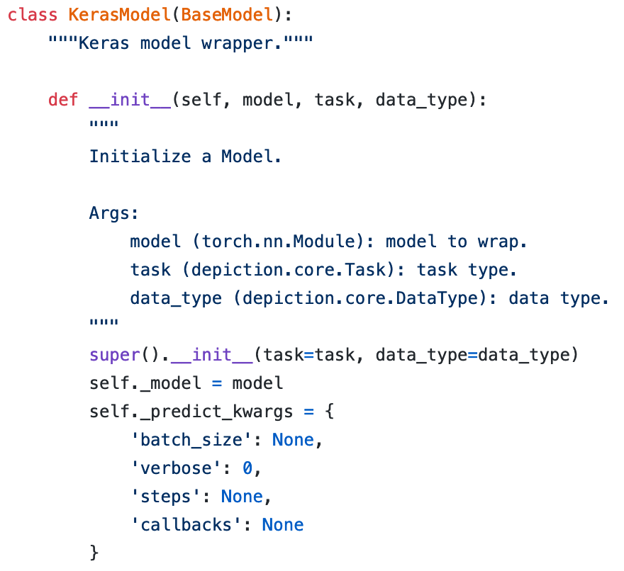
Example: Keras
Notes:
Interpretability is one of those concepts that everybody kinda knows what it is, but at the same time is difficult to pinpoint. So before talking about what interpretability is, let's first see why we would want it.
I do research in interpretability with applications in systems biology and healthcare so I have 3 main reasons why I'd like to achieve interpretability, whatever that is.

Slide 23
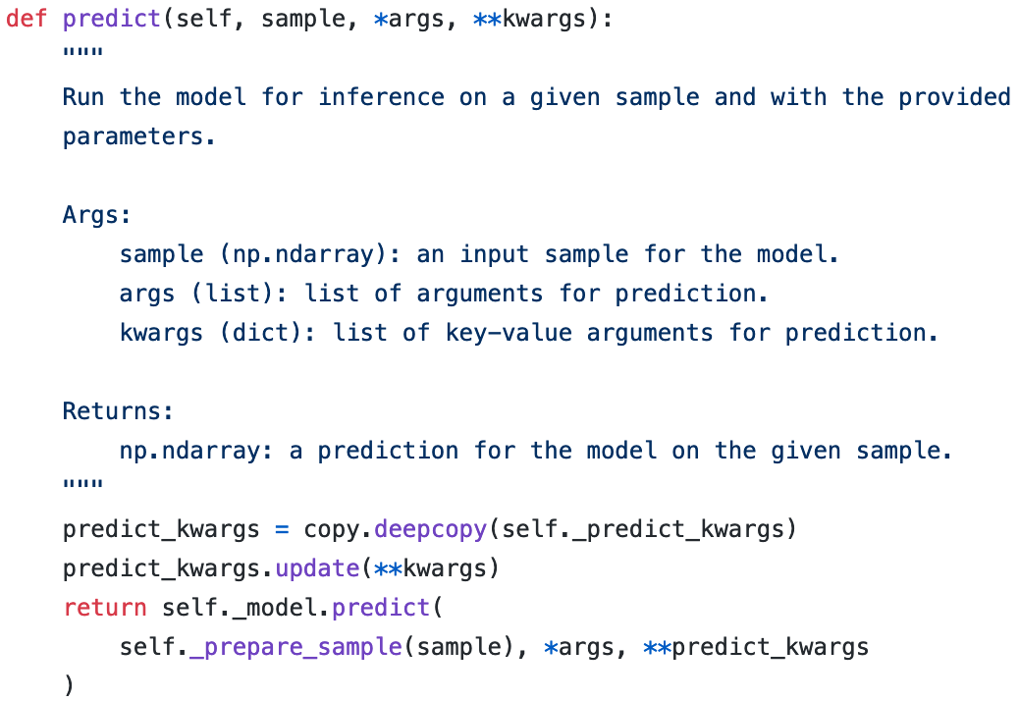
Example: Keras
Notes:
Interpretability is one of those concepts that everybody kinda knows what it is, but at the same time is difficult to pinpoint. So before talking about what interpretability is, let's first see why we would want it.
I do research in interpretability with applications in systems biology and healthcare so I have 3 main reasons why I'd like to achieve interpretability, whatever that is.

Slide 24
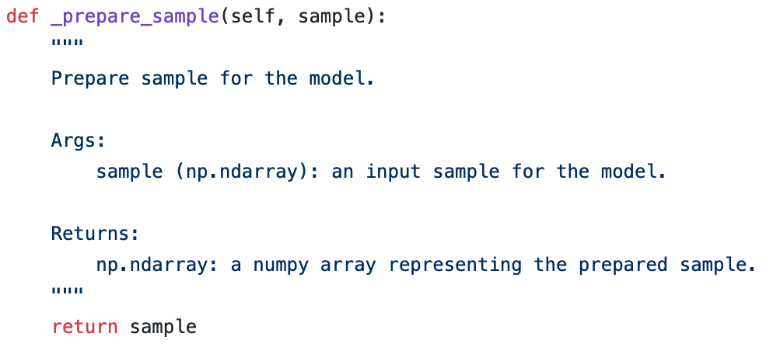
Example: Keras
Notes:
Interpretability is one of those concepts that everybody kinda knows what it is, but at the same time is difficult to pinpoint. So before talking about what interpretability is, let's first see why we would want it.
I do research in interpretability with applications in systems biology and healthcare so I have 3 main reasons why I'd like to achieve interpretability, whatever that is.

Slide 25
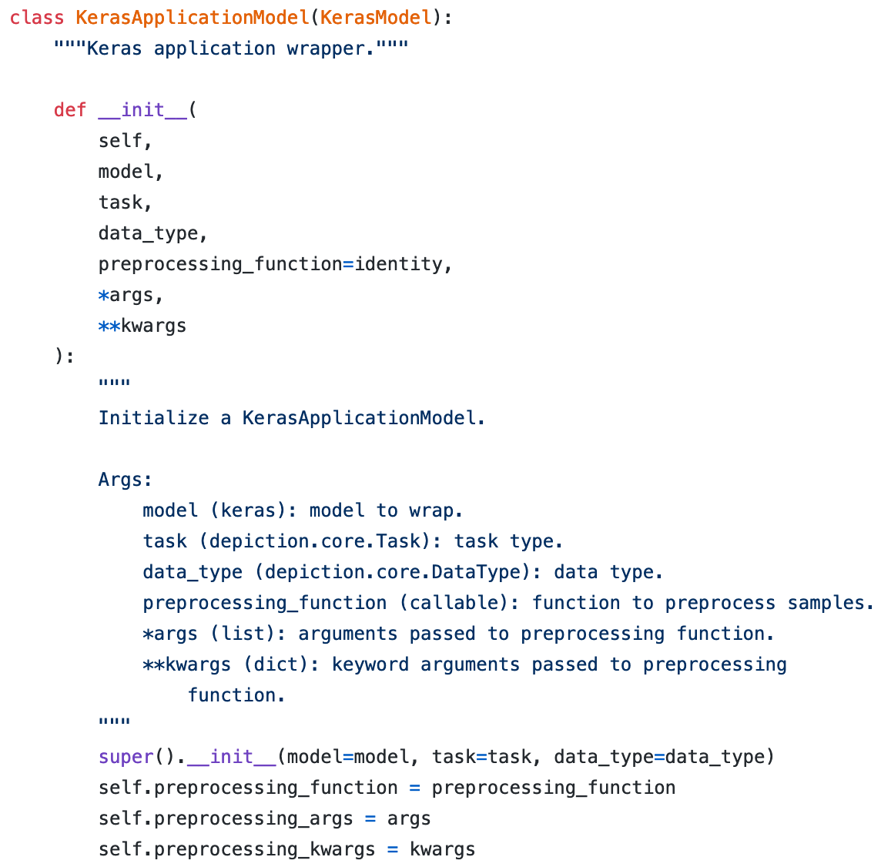
Example: Keras
Notes:
Interpretability is one of those concepts that everybody kinda knows what it is, but at the same time is difficult to pinpoint. So before talking about what interpretability is, let's first see why we would want it.
I do research in interpretability with applications in systems biology and healthcare so I have 3 main reasons why I'd like to achieve interpretability, whatever that is.

Slide 26
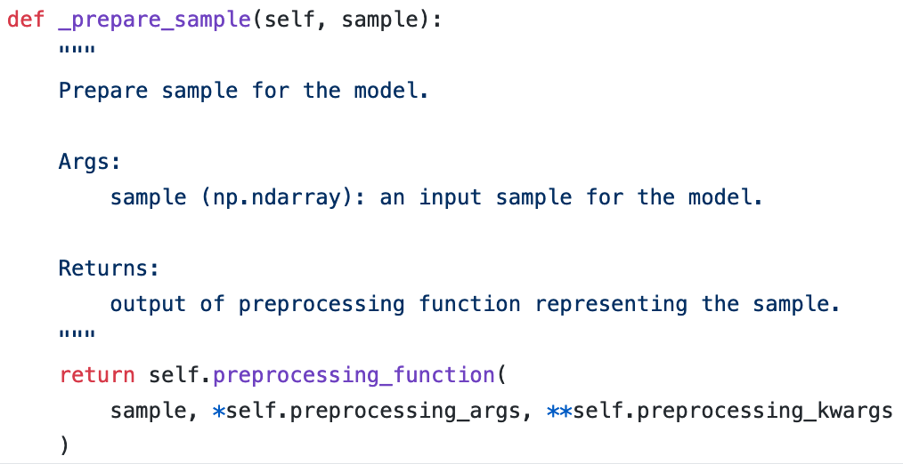
Example: Keras
Notes:
Interpretability is one of those concepts that everybody kinda knows what it is, but at the same time is difficult to pinpoint. So before talking about what interpretability is, let's first see why we would want it.
I do research in interpretability with applications in systems biology and healthcare so I have 3 main reasons why I'd like to achieve interpretability, whatever that is.

Slide 27
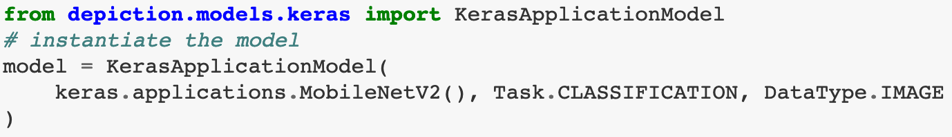
Example: Keras
Notes:
Interpretability is one of those concepts that everybody kinda knows what it is, but at the same time is difficult to pinpoint. So before talking about what interpretability is, let's first see why we would want it.
I do research in interpretability with applications in systems biology and healthcare so I have 3 main reasons why I'd like to achieve interpretability, whatever that is.

Slide 28
Example: PyTorch
Notes:
Interpretability is one of those concepts that everybody kinda knows what it is, but at the same time is difficult to pinpoint. So before talking about what interpretability is, let's first see why we would want it.
I do research in interpretability with applications in systems biology and healthcare so I have 3 main reasons why I'd like to achieve interpretability, whatever that is.

Slide 29
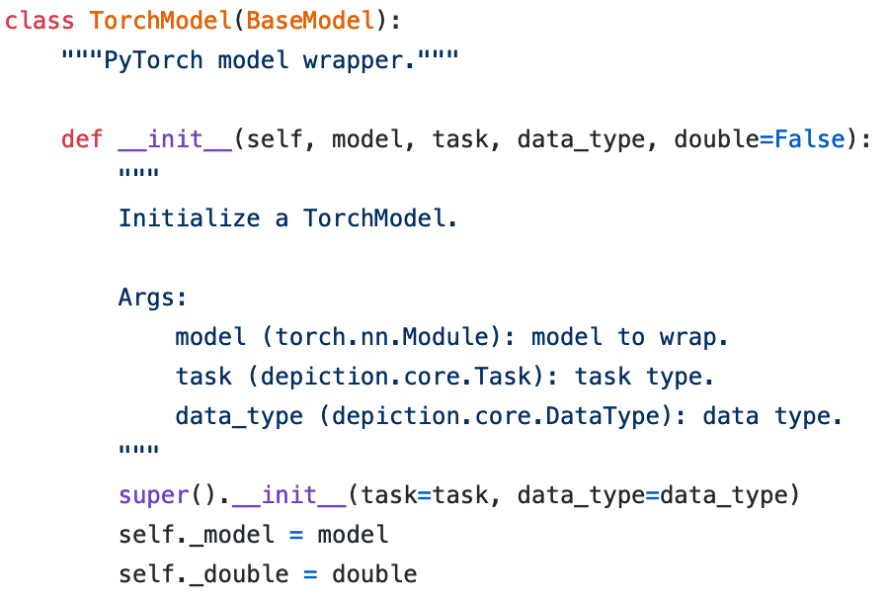
Example: PyTorch
Notes:
Interpretability is one of those concepts that everybody kinda knows what it is, but at the same time is difficult to pinpoint. So before talking about what interpretability is, let's first see why we would want it.
I do research in interpretability with applications in systems biology and healthcare so I have 3 main reasons why I'd like to achieve interpretability, whatever that is.

Slide 30
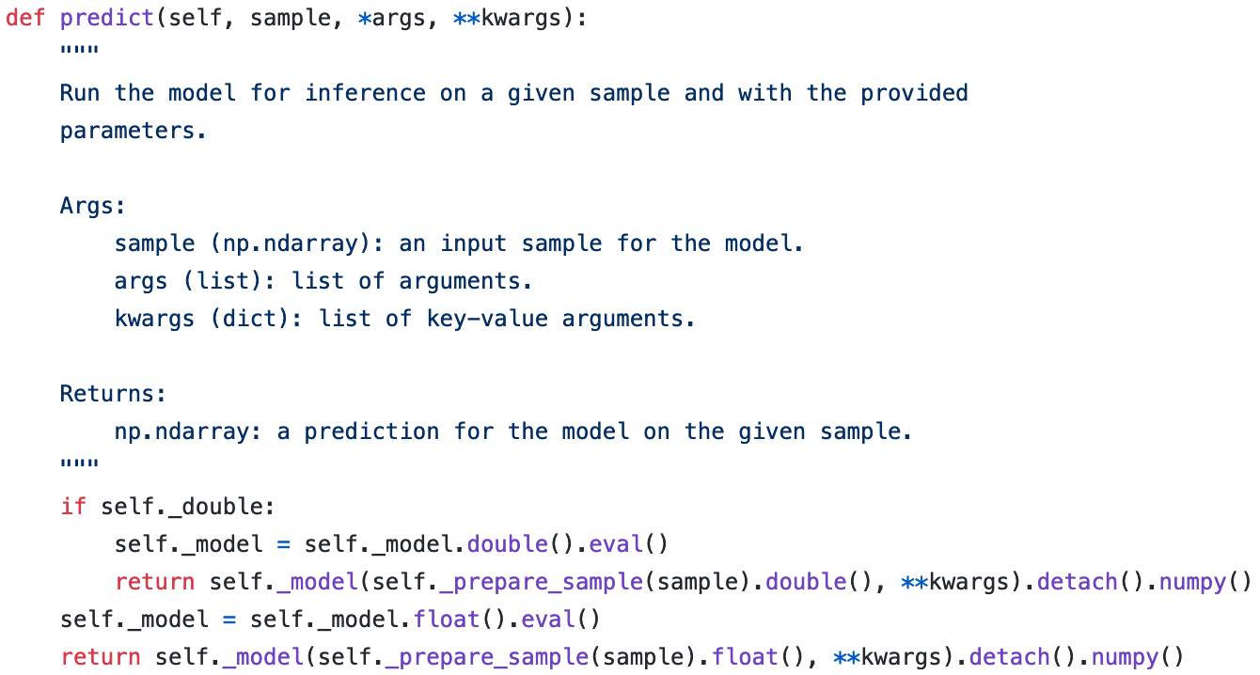
Example: PyTorch
Notes:
Interpretability is one of those concepts that everybody kinda knows what it is, but at the same time is difficult to pinpoint. So before talking about what interpretability is, let's first see why we would want it.
I do research in interpretability with applications in systems biology and healthcare so I have 3 main reasons why I'd like to achieve interpretability, whatever that is.

Slide 31
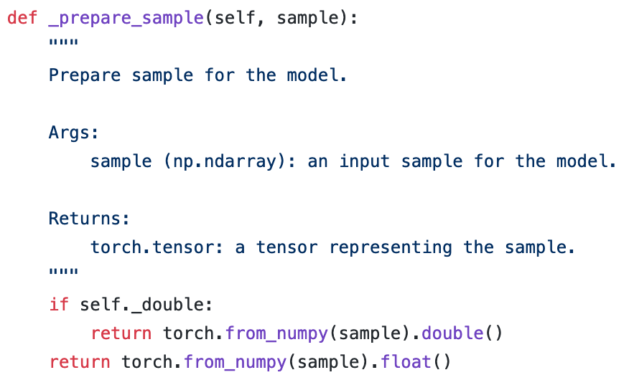
Example: PyTorch
Notes:
Interpretability is one of those concepts that everybody kinda knows what it is, but at the same time is difficult to pinpoint. So before talking about what interpretability is, let's first see why we would want it.
I do research in interpretability with applications in systems biology and healthcare so I have 3 main reasons why I'd like to achieve interpretability, whatever that is.

Slide 32
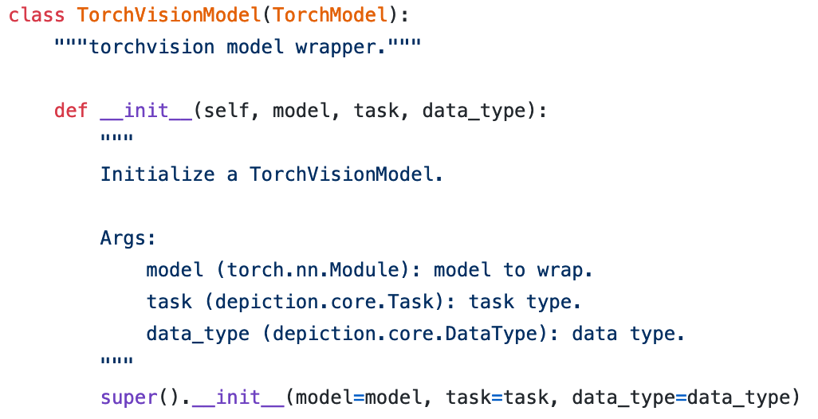
Example: PyTorch
Notes:
Interpretability is one of those concepts that everybody kinda knows what it is, but at the same time is difficult to pinpoint. So before talking about what interpretability is, let's first see why we would want it.
I do research in interpretability with applications in systems biology and healthcare so I have 3 main reasons why I'd like to achieve interpretability, whatever that is.

Slide 33
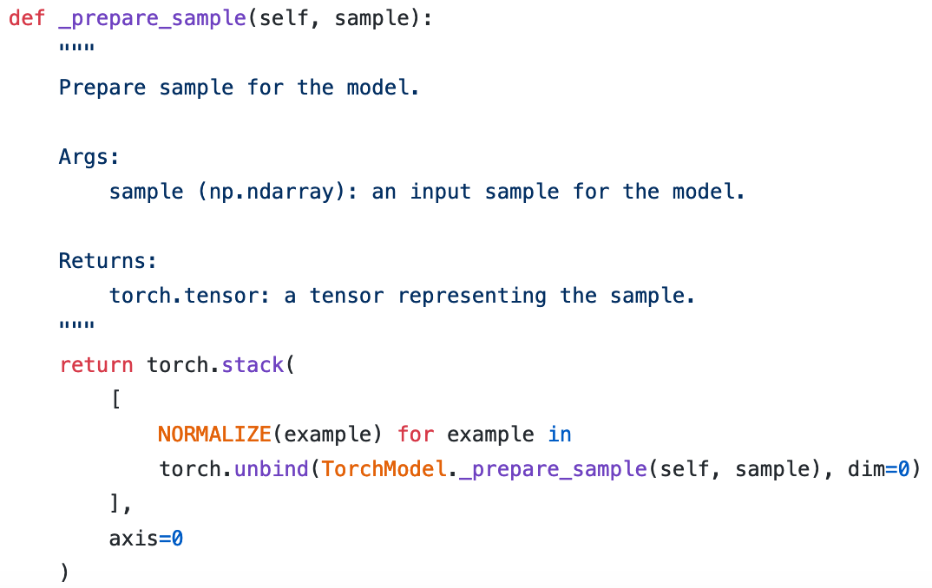
Example: PyTorch
Notes:
Interpretability is one of those concepts that everybody kinda knows what it is, but at the same time is difficult to pinpoint. So before talking about what interpretability is, let's first see why we would want it.
I do research in interpretability with applications in systems biology and healthcare so I have 3 main reasons why I'd like to achieve interpretability, whatever that is.

Slide 34
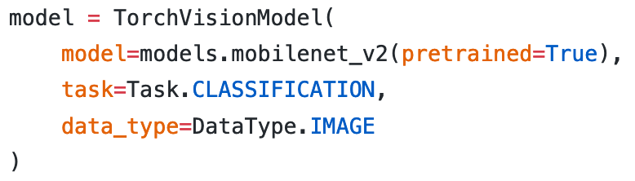
Example: PyTorch
Notes:
Interpretability is one of those concepts that everybody kinda knows what it is, but at the same time is difficult to pinpoint. So before talking about what interpretability is, let's first see why we would want it.
I do research in interpretability with applications in systems biology and healthcare so I have 3 main reasons why I'd like to achieve interpretability, whatever that is.

Slide 35
Example: MAX
https://developer.ibm.com/exchanges/models/all/
Notes:
Interpretability is one of those concepts that everybody kinda knows what it is, but at the same time is difficult to pinpoint. So before talking about what interpretability is, let's first see why we would want it.
I do research in interpretability with applications in systems biology and healthcare so I have 3 main reasons why I'd like to achieve interpretability, whatever that is.

Slide 36
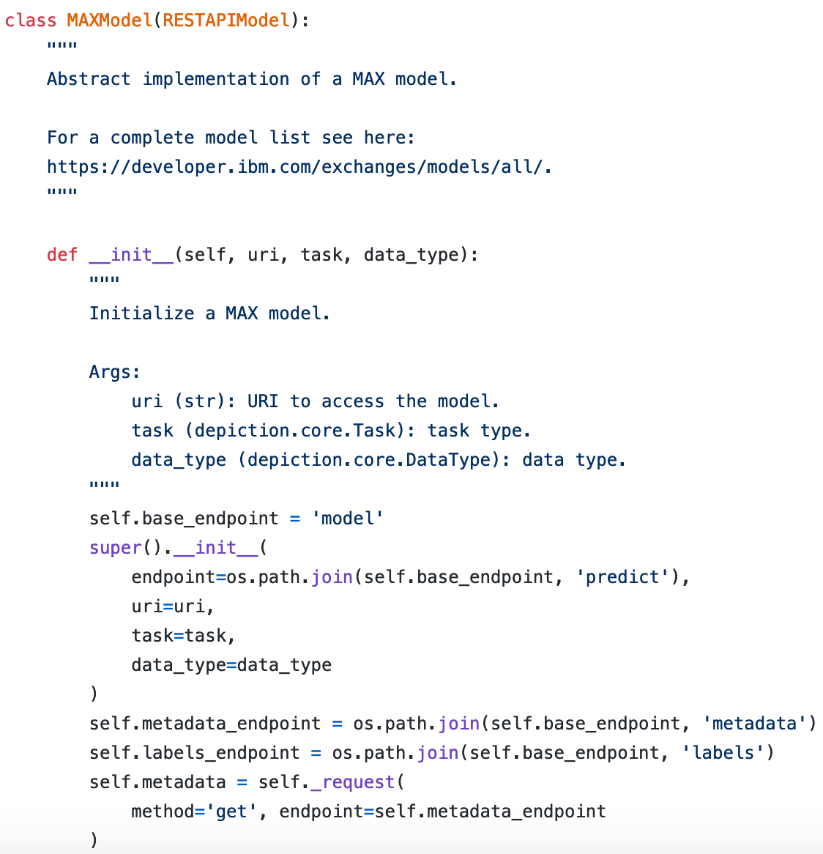
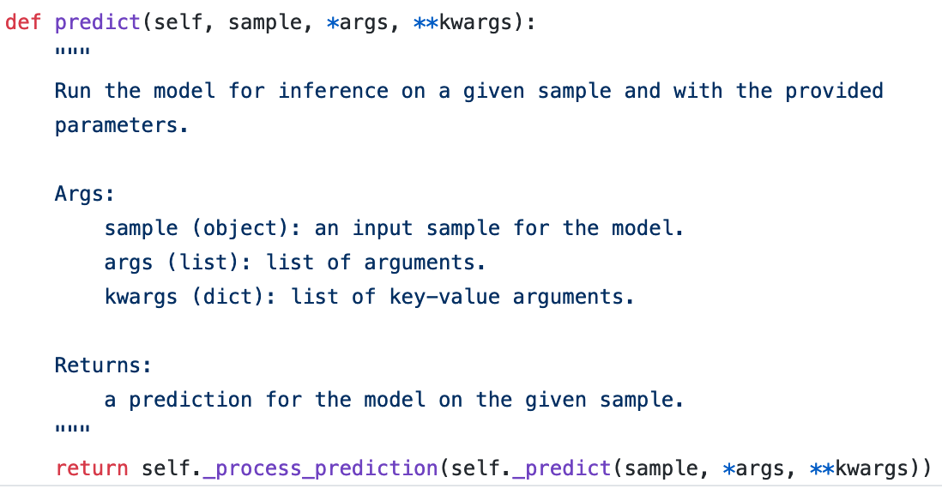
Example: MAX
https://developer.ibm.com/exchanges/models/all/
Notes:
Interpretability is one of those concepts that everybody kinda knows what it is, but at the same time is difficult to pinpoint. So before talking about what interpretability is, let's first see why we would want it.
I do research in interpretability with applications in systems biology and healthcare so I have 3 main reasons why I'd like to achieve interpretability, whatever that is.

Slide 37
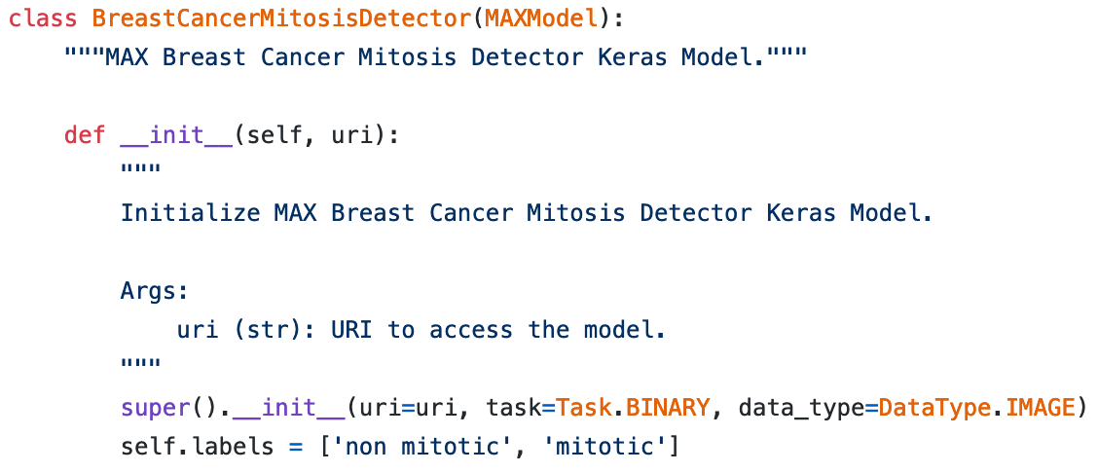
Example: MAX
https://developer.ibm.com/exchanges/models/all/max-breast-cancer-mitosis-detector/
Notes:
Interpretability is one of those concepts that everybody kinda knows what it is, but at the same time is difficult to pinpoint. So before talking about what interpretability is, let's first see why we would want it.
I do research in interpretability with applications in systems biology and healthcare so I have 3 main reasons why I'd like to achieve interpretability, whatever that is.

Slide 38
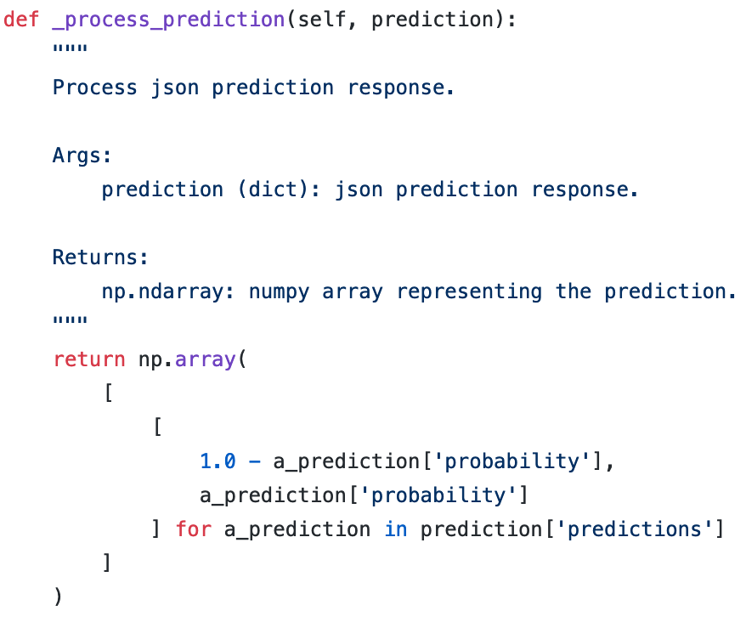
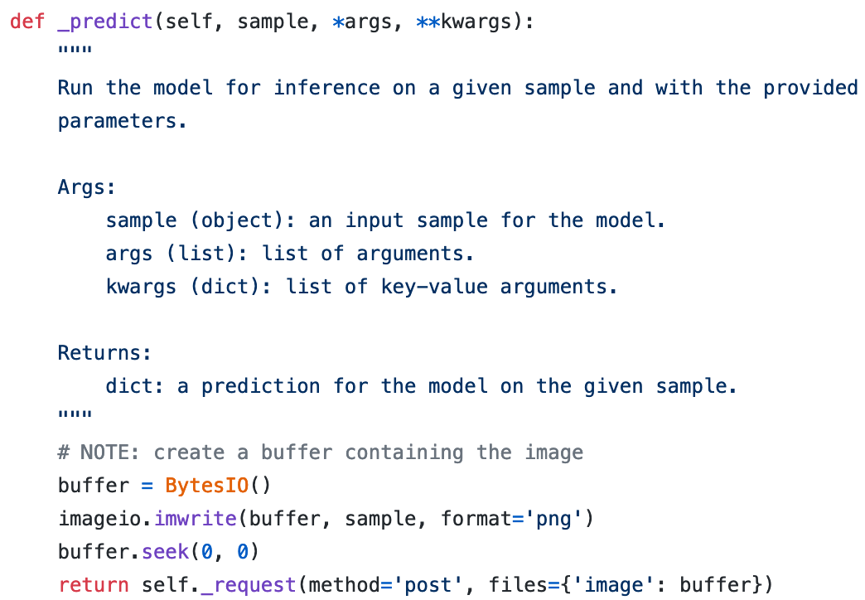
Example: MAX
https://developer.ibm.com/exchanges/models/all/max-breast-cancer-mitosis-detector/
Notes:
Interpretability is one of those concepts that everybody kinda knows what it is, but at the same time is difficult to pinpoint. So before talking about what interpretability is, let's first see why we would want it.
I do research in interpretability with applications in systems biology and healthcare so I have 3 main reasons why I'd like to achieve interpretability, whatever that is.

Slide 39
Example: Kipoi
https://kipoi.org/
Notes:
Interpretability is one of those concepts that everybody kinda knows what it is, but at the same time is difficult to pinpoint. So before talking about what interpretability is, let's first see why we would want it.
I do research in interpretability with applications in systems biology and healthcare so I have 3 main reasons why I'd like to achieve interpretability, whatever that is.

Slide 40
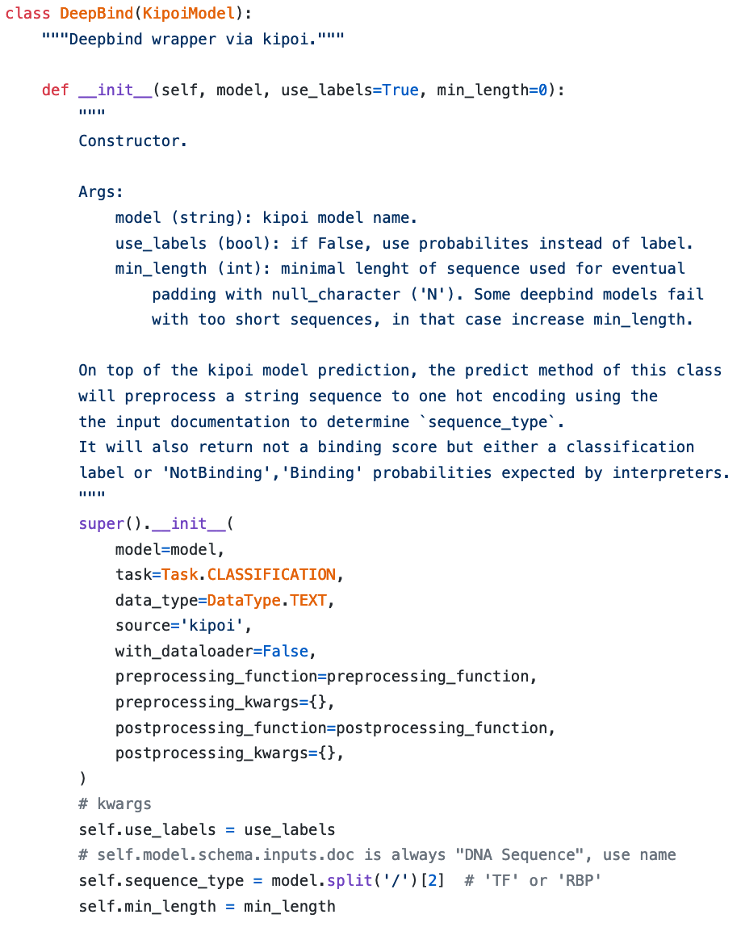
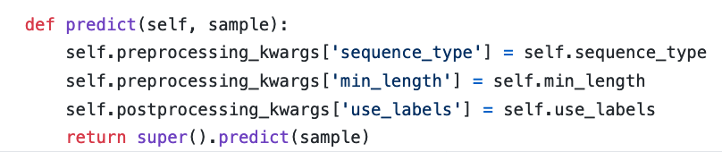
Example: Kipoi
https://kipoi.org/
Notes:
Interpretability is one of those concepts that everybody kinda knows what it is, but at the same time is difficult to pinpoint. So before talking about what interpretability is, let's first see why we would want it.
I do research in interpretability with applications in systems biology and healthcare so I have 3 main reasons why I'd like to achieve interpretability, whatever that is.

Slide 41
Example: HttpModel
Notes:
Interpretability is one of those concepts that everybody kinda knows what it is, but at the same time is difficult to pinpoint. So before talking about what interpretability is, let's first see why we would want it.
I do research in interpretability with applications in systems biology and healthcare so I have 3 main reasons why I'd like to achieve interpretability, whatever that is.

Slide 42
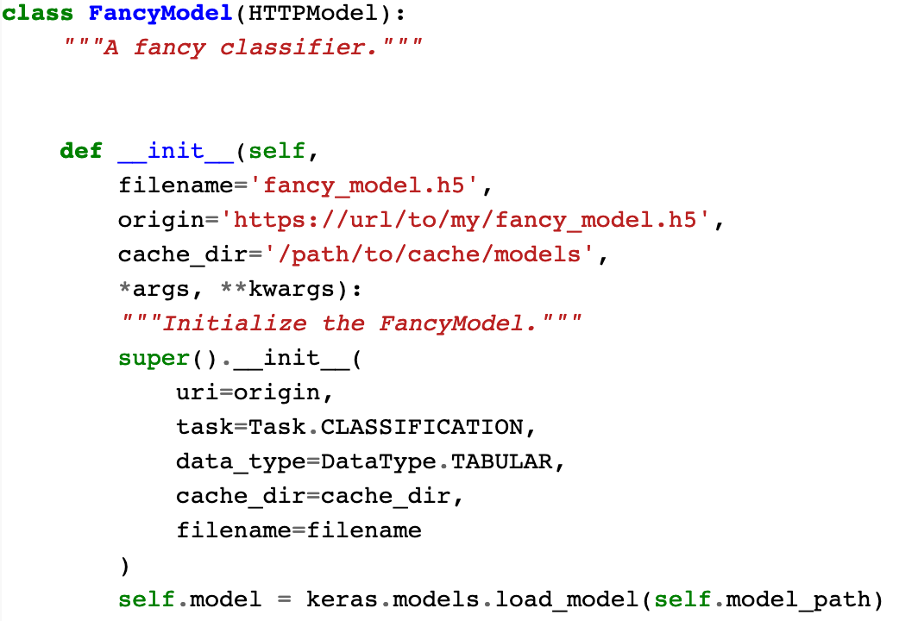
Example: HttpModel
Notes:
Interpretability is one of those concepts that everybody kinda knows what it is, but at the same time is difficult to pinpoint. So before talking about what interpretability is, let's first see why we would want it.
I do research in interpretability with applications in systems biology and healthcare so I have 3 main reasons why I'd like to achieve interpretability, whatever that is.

Slide 43
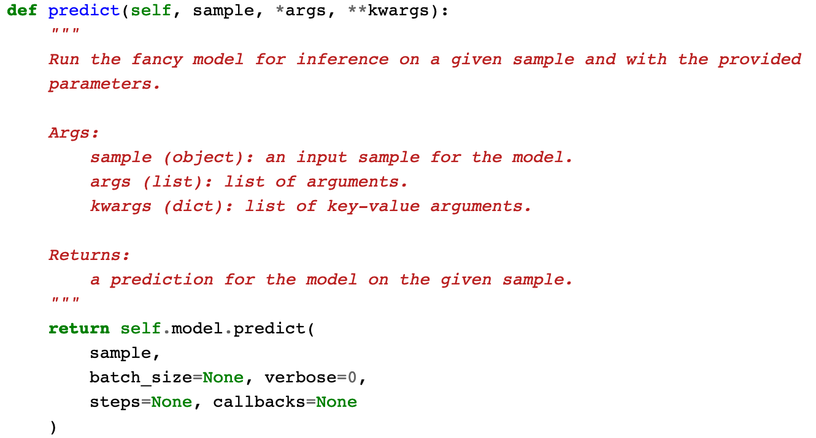
Example: HttpModel
Notes:
Interpretability is one of those concepts that everybody kinda knows what it is, but at the same time is difficult to pinpoint. So before talking about what interpretability is, let's first see why we would want it.
I do research in interpretability with applications in systems biology and healthcare so I have 3 main reasons why I'd like to achieve interpretability, whatever that is.

Slide 44
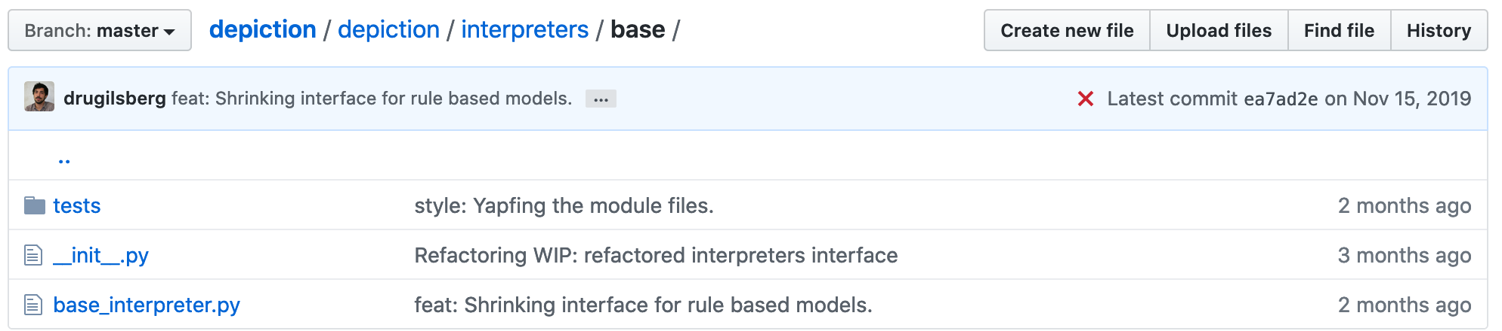
Interpreter interface
Notes:
Interpretability is one of those concepts that everybody kinda knows what it is, but at the same time is difficult to pinpoint. So before talking about what interpretability is, let's first see why we would want it.
I do research in interpretability with applications in systems biology and healthcare so I have 3 main reasons why I'd like to achieve interpretability, whatever that is.

Slide 45
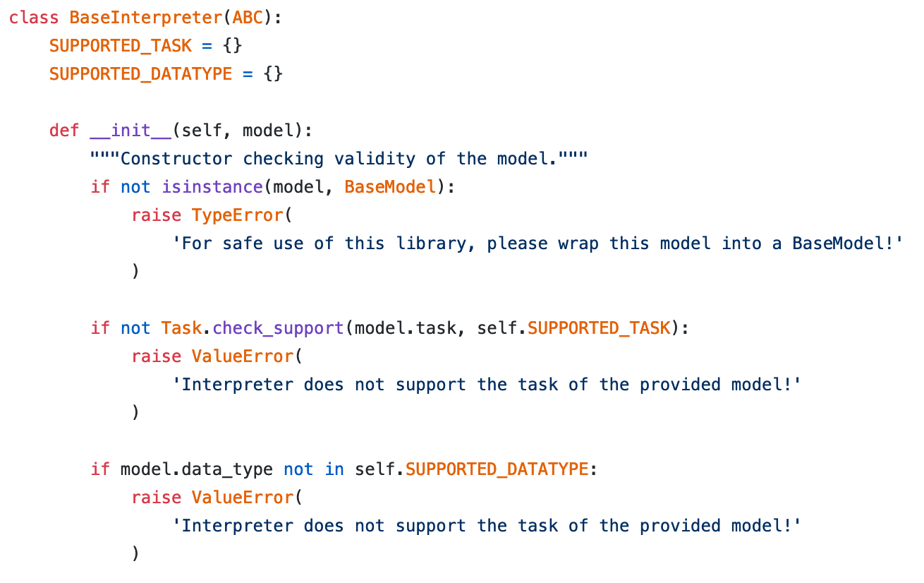
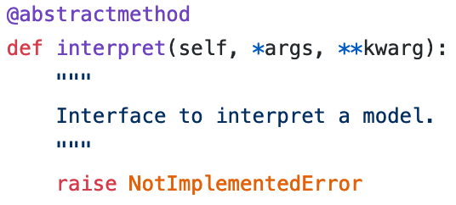
Interpreter interface
Notes:
Interpretability is one of those concepts that everybody kinda knows what it is, but at the same time is difficult to pinpoint. So before talking about what interpretability is, let's first see why we would want it.
I do research in interpretability with applications in systems biology and healthcare so I have 3 main reasons why I'd like to achieve interpretability, whatever that is.

Slide 46
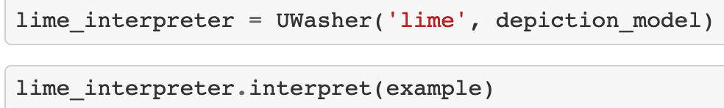
Examples
Notes:
Interpretability is one of those concepts that everybody kinda knows what it is, but at the same time is difficult to pinpoint. So before talking about what interpretability is, let's first see why we would want it.
I do research in interpretability with applications in systems biology and healthcare so I have 3 main reasons why I'd like to achieve interpretability, whatever that is.

Slide 47
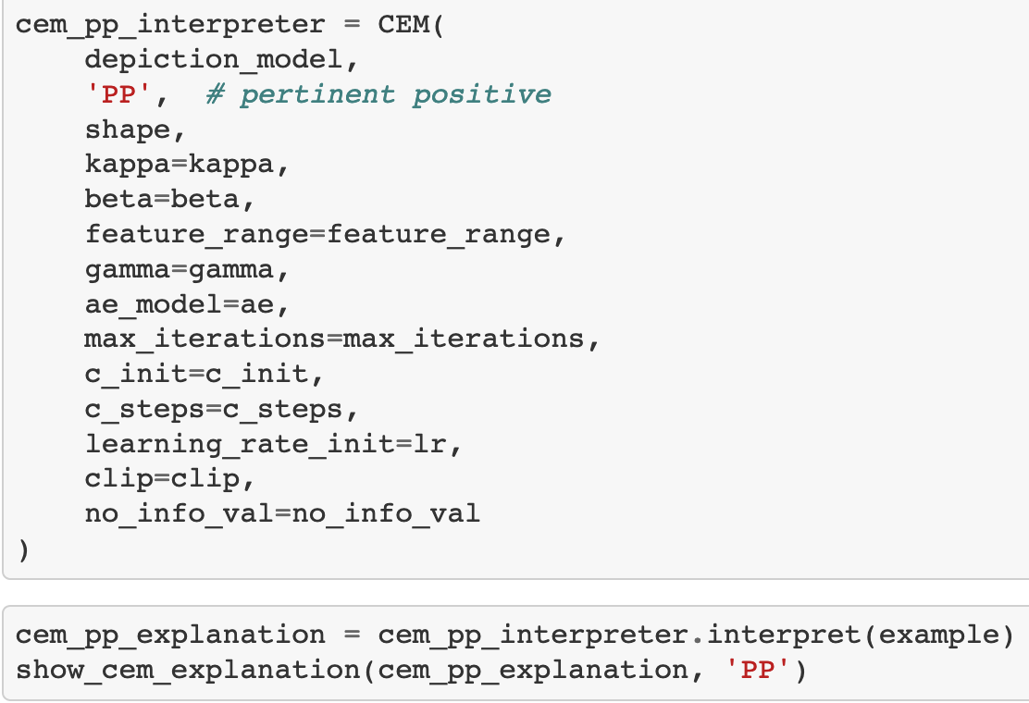
Examples
Notes:
Interpretability is one of those concepts that everybody kinda knows what it is, but at the same time is difficult to pinpoint. So before talking about what interpretability is, let's first see why we would want it.
I do research in interpretability with applications in systems biology and healthcare so I have 3 main reasons why I'd like to achieve interpretability, whatever that is.

Slide 48
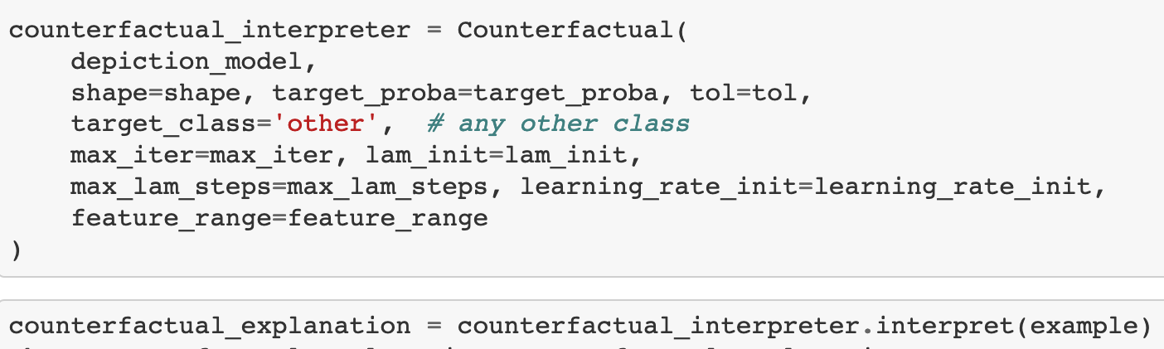
Examples
Notes:
Interpretability is one of those concepts that everybody kinda knows what it is, but at the same time is difficult to pinpoint. So before talking about what interpretability is, let's first see why we would want it.
I do research in interpretability with applications in systems biology and healthcare so I have 3 main reasons why I'd like to achieve interpretability, whatever that is.

Slide 49
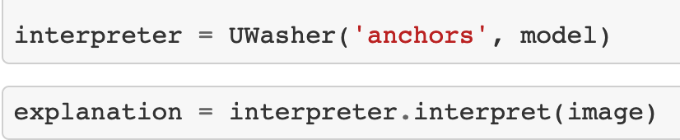
Examples
Notes:
Interpretability is one of those concepts that everybody kinda knows what it is, but at the same time is difficult to pinpoint. So before talking about what interpretability is, let's first see why we would want it.
I do research in interpretability with applications in systems biology and healthcare so I have 3 main reasons why I'd like to achieve interpretability, whatever that is.

Slide 50
Examples
Notes:
Interpretability is one of those concepts that everybody kinda knows what it is, but at the same time is difficult to pinpoint. So before talking about what interpretability is, let's first see why we would want it.
I do research in interpretability with applications in systems biology and healthcare so I have 3 main reasons why I'd like to achieve interpretability, whatever that is.

Slide 51
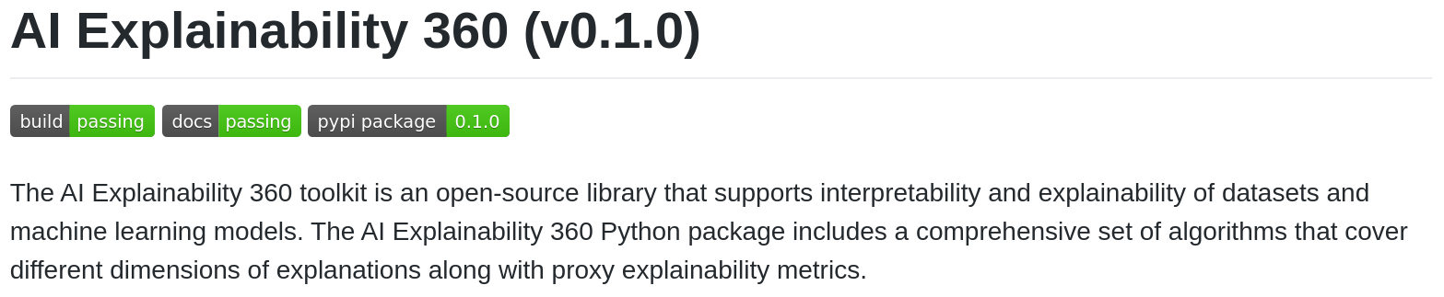
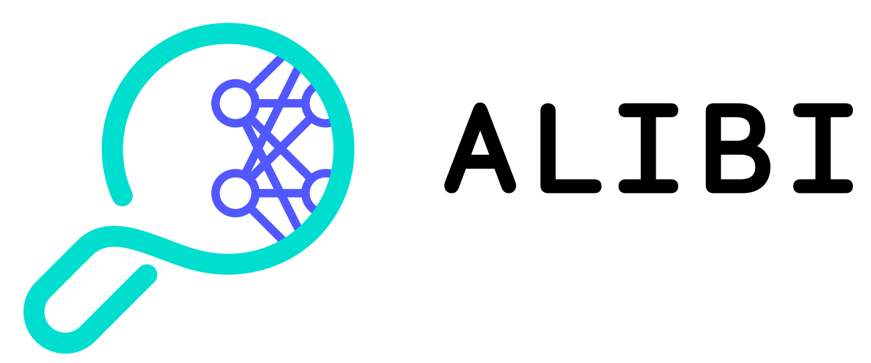
Integrations
https://aix360.mybluemix.net/
https://docs.seldon.io/projects/alibi/en/stable/
Notes:
Interpretability is one of those concepts that everybody kinda knows what it is, but at the same time is difficult to pinpoint. So before talking about what interpretability is, let's first see why we would want it.
I do research in interpretability with applications in systems biology and healthcare so I have 3 main reasons why I'd like to achieve interpretability, whatever that is.

Slide 52


Framework-specific integrations
https://captum.ai/
https://tf-explain.readthedocs.io/en/latest/overview.html
Notes:
Interpretability is one of those concepts that everybody kinda knows what it is, but at the same time is difficult to pinpoint. So before talking about what interpretability is, let's first see why we would want it.
I do research in interpretability with applications in systems biology and healthcare so I have 3 main reasons why I'd like to achieve interpretability, whatever that is.

Slide 53
IBM sign-off
IBM Research

